Slide 1
Grid Action Plan – Action 6: Grid Hosting Capacities

Slide 2
Grid Action Plan 06- Grid Hosting Capacity Definitions & Pan-EU Overview
Supporting definitions (Capacitypedia)
Key aspects relevant for understanding grid hosting capacities, including granularity,
firm and flexible connection capacity, coordination between DSOs and TSOs etc.
Background
Requirements from the Grid Action Plan – Action 6 on Hosting Capacities
Collaborative efforts (Exchanges and Proposals) between ENTSO-E and EU DSO Entity
Feedback and guidance from the European Commission
Information portal to the grid hosting capacity information websites Serves as a single-entry point for users, enabling easy navigation of grid hosting capacities and providing access to websites displaying current grid hosting capacity status
Sharing of good practices Promoting an aligned approach among different system operators considering inputs from stakeholders

Slide 3










EU Stakeholder Involvement for Capacitypedia and Information Portal & Indicative Timeline
2024
2025
2026
July
September
November
January
March
May
July
September
November
January
March
May
Kickoff Joint TF
Kickoff with EC
1st Stakeholder Webinar
2nd Stakeholder Webinar
Stakeholder Meetings (tbc)
EU STAKEHOLDER GROUP
Renewables
Wind Europe
Solar Power Europe
Institutional
European Commission
ACER
Market Agents
Eurelectric
EFET
Hydrogen Europe
Electromobility
ChargeUp Europe
AVERE
Energy Consumer
IFIEC Europe
CEDEC
BEUC
SmartEN
Heating and
cooling
EHI
EHPA
Energy Storage
EASE
BEPA
Others
CAN Europe
RAP, RGI, EPRI
T&D Europe
EU Turbines
Establishment of Joint Task Force, Setting up Goals, Joint Work Plan & Collection of Published Hosting Capacity Information & Definitions
Mock-up & Establishment of
target platform
Platform Go-live
Pan-EU overview
Progress/Concept Report at Copenhagen Forum
Q2 25
Preliminary outputs for hosting capacity descriptions
Q4 25
Notes:
Being available before

Slide 4

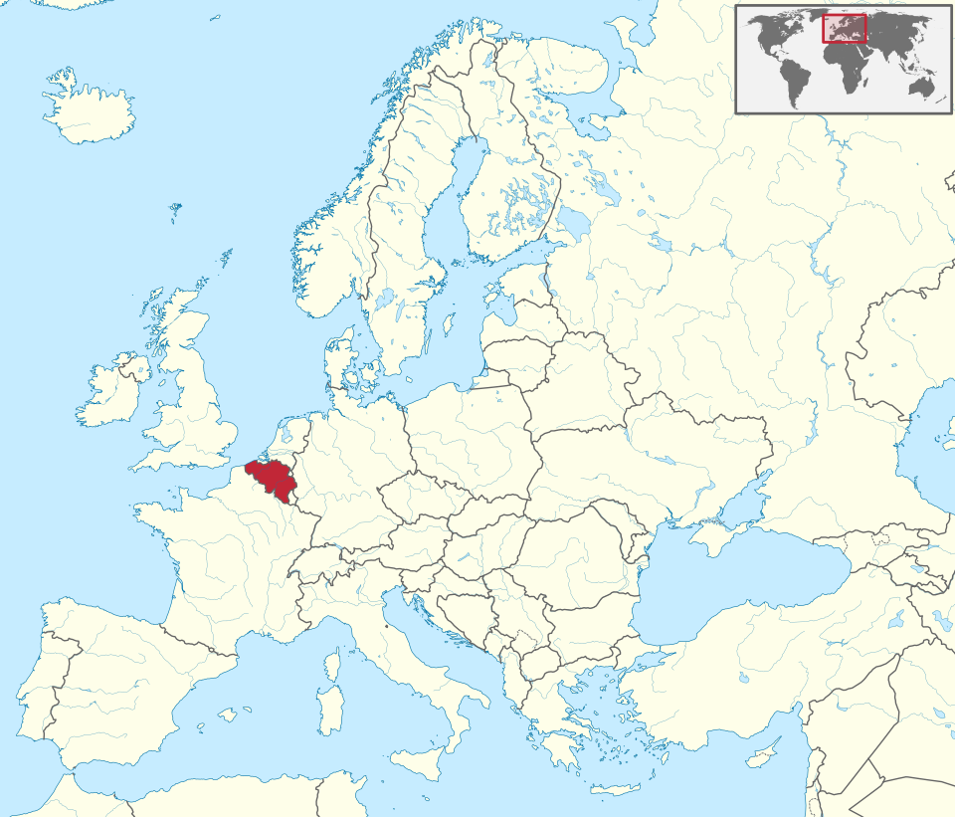


Conceptual ideas for Information portal Capacitypedia &Pan EU Overview on Grid Hosting Capacities
Country’s subpage (e.g. Belgium)
Capacitypedia
Guide for understanding grid hosting capacity information and used definitions
Country’s status, responsibility for publishing national information, main contacts and links
Good practices
TSOs
DSOs
Effective practices implemented by DSOs and/or TSOs
TSO grid hosting capacity information, additional links to national maps (if any) or tables, definitions and disclaimers
DSO grid hosting capacity information, additional links to national maps (if any) or tables, definitions and disclaimers
(links, contacts and subpages to capture the diversity)

Slide 5
Grid Action Plan – Action 6: Digitalising and Streamlining Grid Connection Requests

Slide 6



Grid Action Plan 06-Digitalising and Streamlining Grid Connection Requests Preliminary Findings
Internal Assessment
Main Observations
Key Enablers to Support Diversity across Europe
Fit-for-purpose automation
Depends on the complexity of the assessments for connection requests
Digital Solutions
User-friendly platform with a certain degree of automated processes enhanced the effectiveness
DSO Entity is conducting a comprehensive assessment to understand the main challenges / enablers and collect good practices that will enable an effective handling of connection requests at distribution grids
Interdependence*
String interdependence with competent authorities and other external stakeholders. Delays in permitting and supply chain disruptions
Enhanced Collaboration
Improved collaboration among grid planners and both internal/external stakeholders
Qualified Labour*
Shortage of skilled labour impacts overall efficiency
Regulatory Innovation*
Flexible connection models that support the timely integration of new connections
Change Management*
Natural resistance to new digital processes and a need for comprehensive upskilling training programmes
*Beyond scope

